Slide 1

Where’s My Stuff?

Slide 2
The Problem
What do I have to pack?
What do I have at the other place?

Slide 3
The Solution – Where‘s My Stuff
Compact overview
Save your belongings to your defined locations
Virtual Suitcase
Select your items you want to carry with you

Slide 4

The Developer
Benedikt Langer
Skills:
Swift
Java
C++
Kotlin

Slide 5
App-Structure
TabBar
Dashboard
MyItems
MyLocation
New Suitcase
AddItem
CreateItem
AddLocation

Slide 6






Features
Virtual Suitcase
Add items to carry with you
Location based
Make location based actions with your items
Notification
Get notification when you are at a certain place
Create own Items
Create your personal Items in different categories
Items-Placing
Add your items to your saved locations
History
Overview of the past journeys

Slide 7
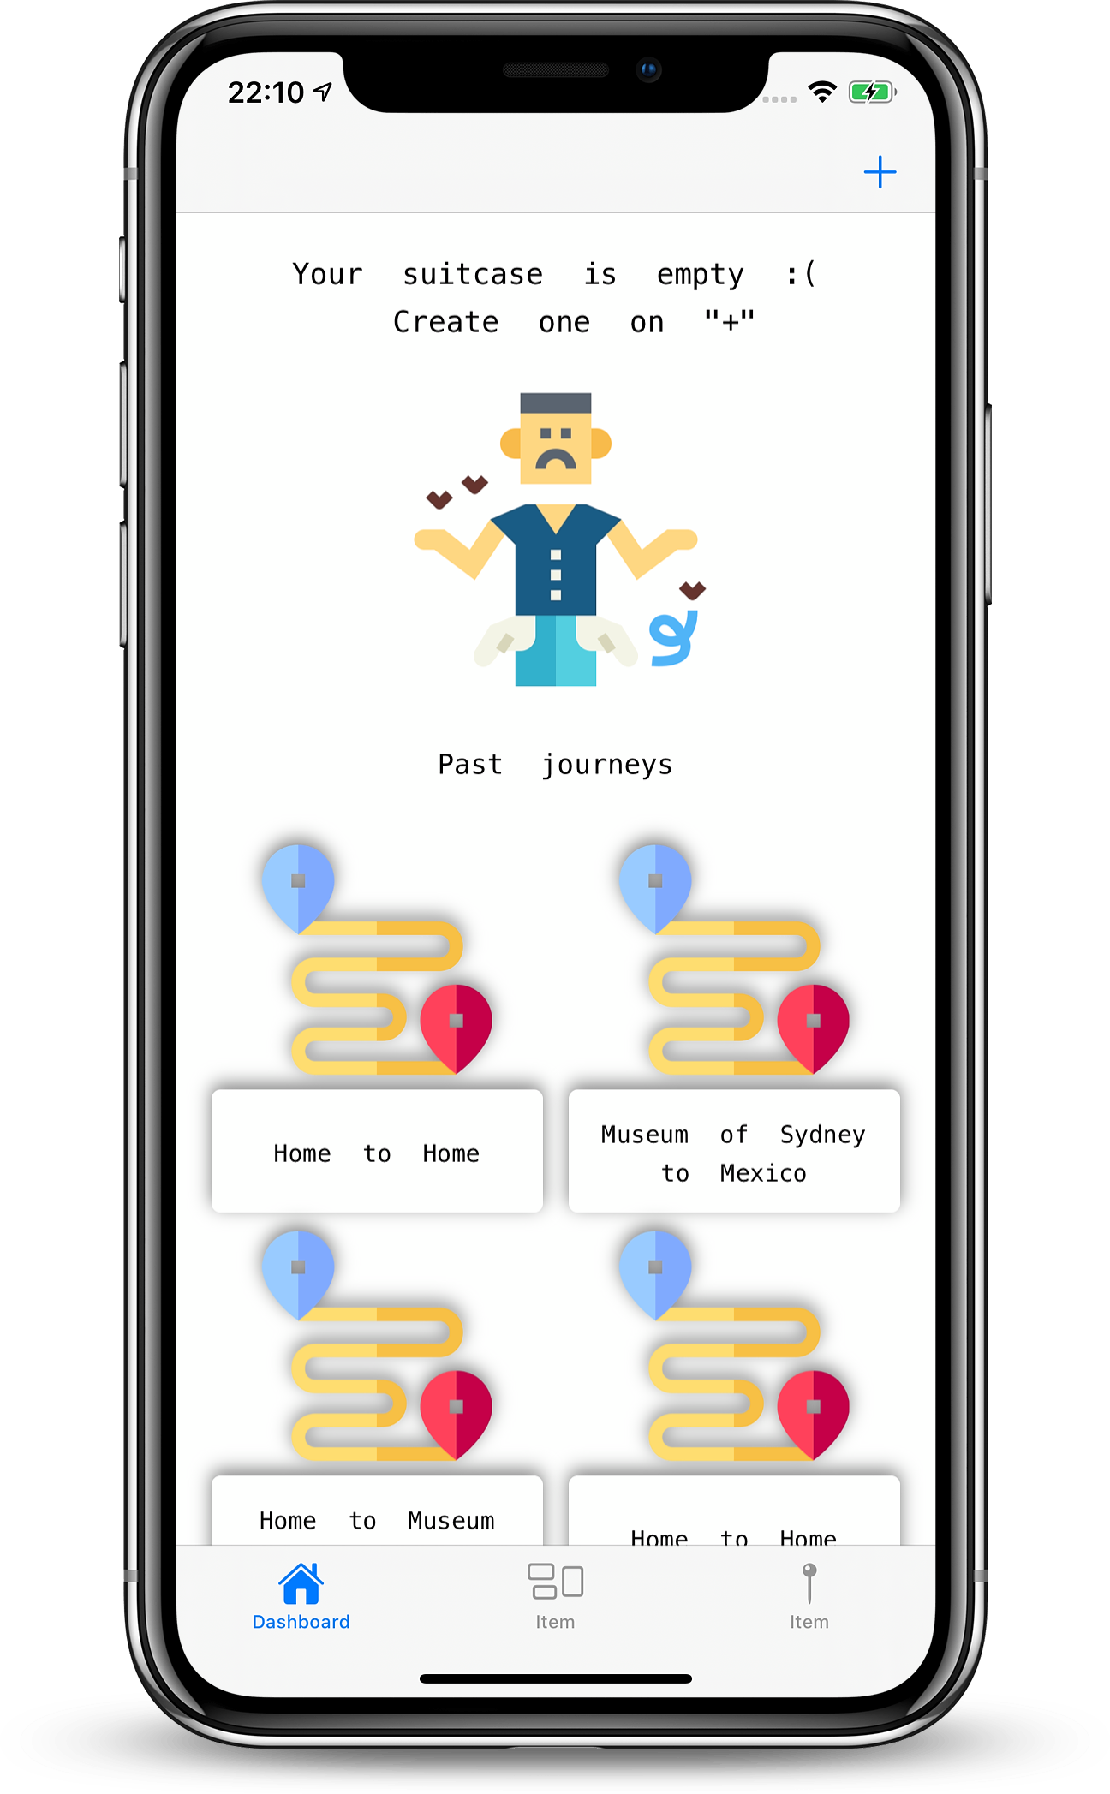

Slide 8
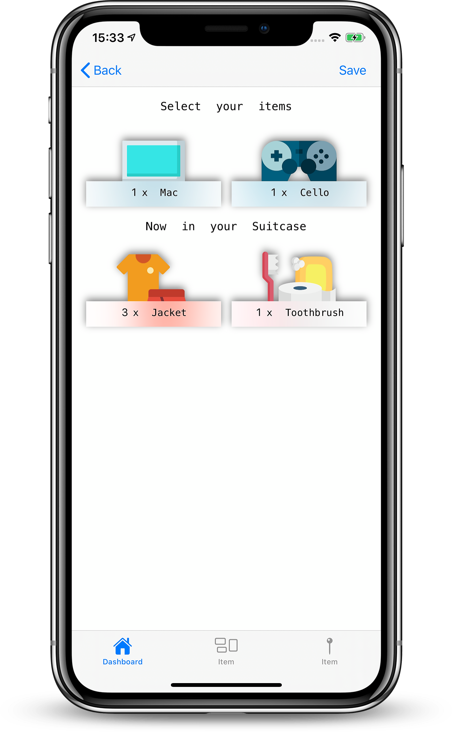
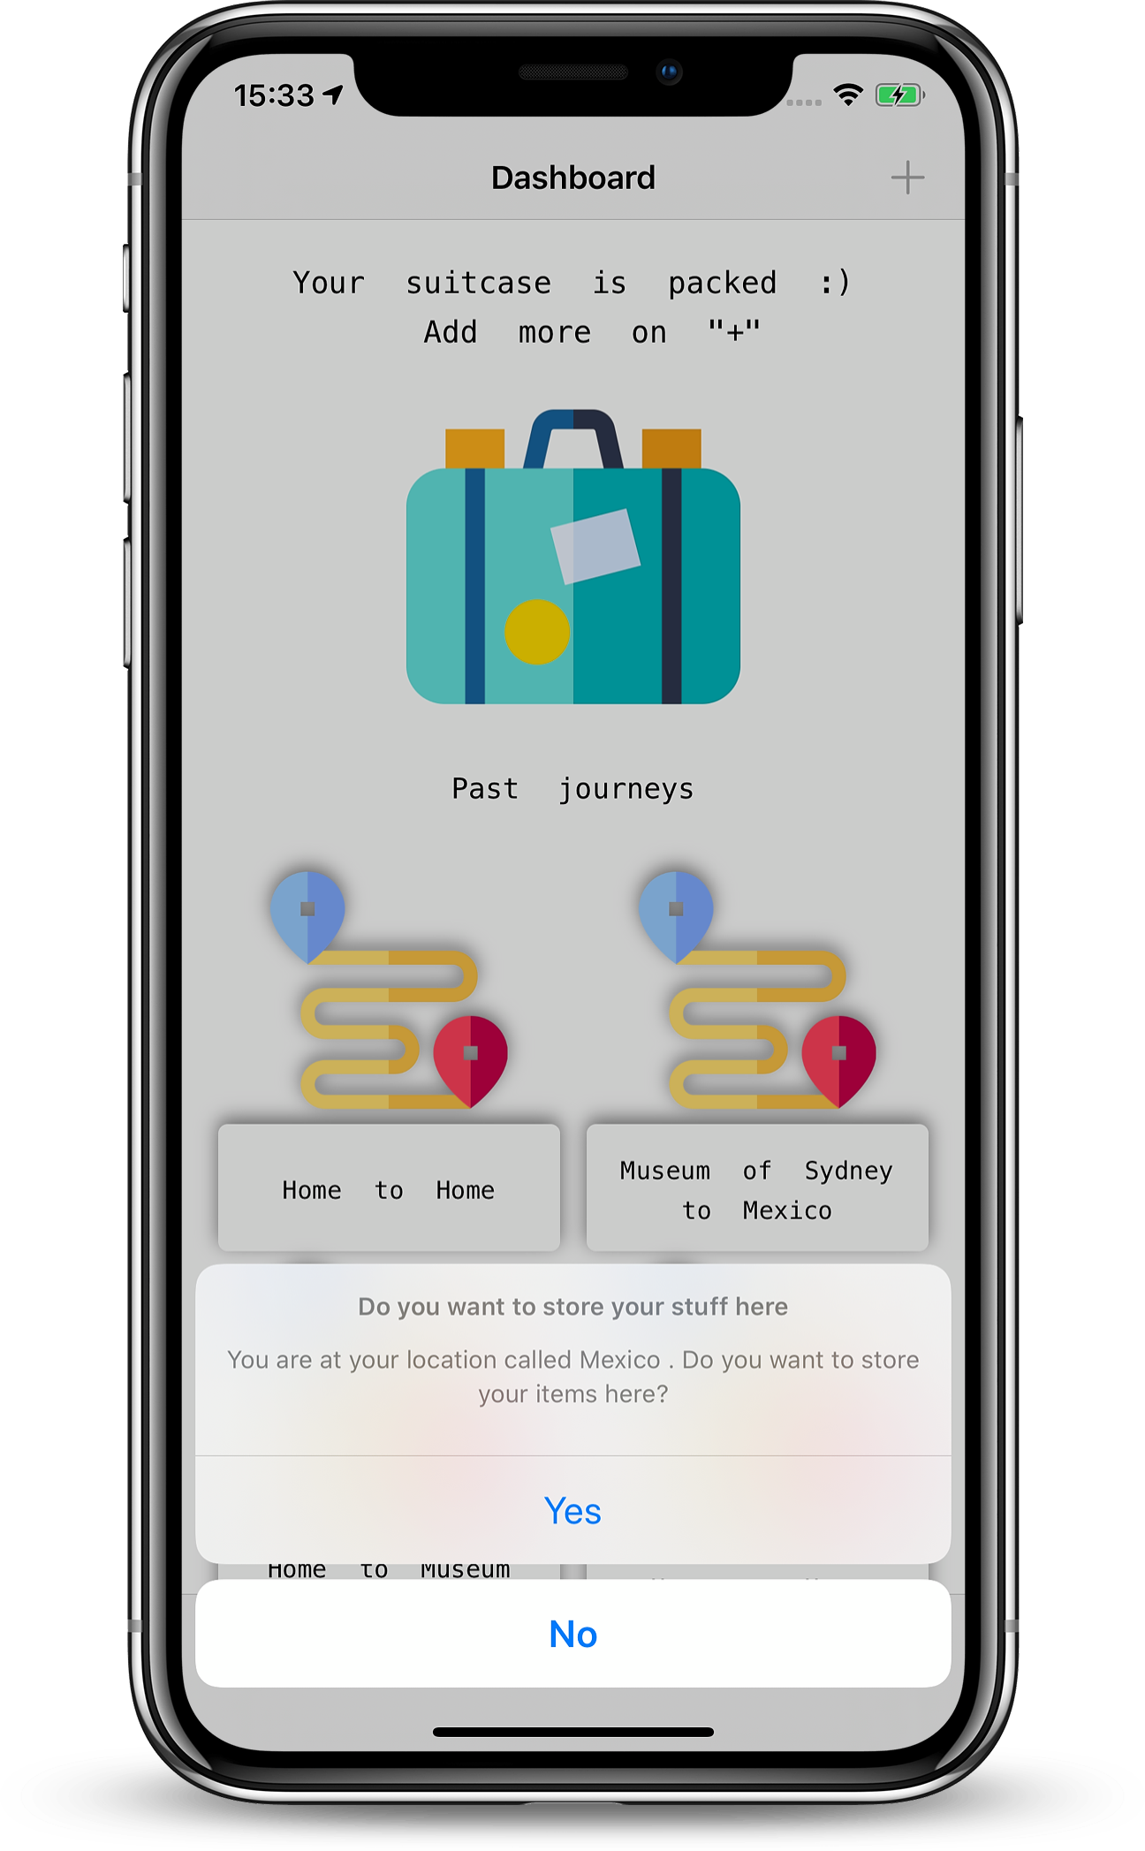

Slide 9
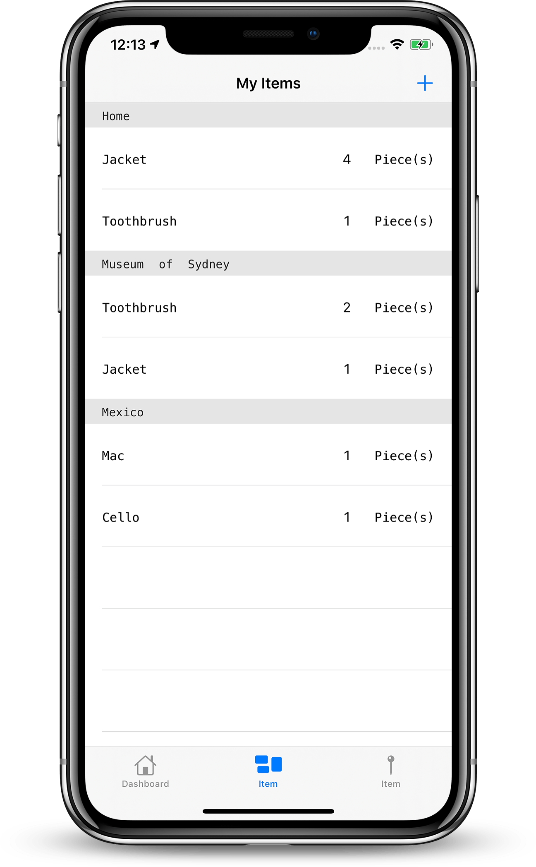

Slide 10
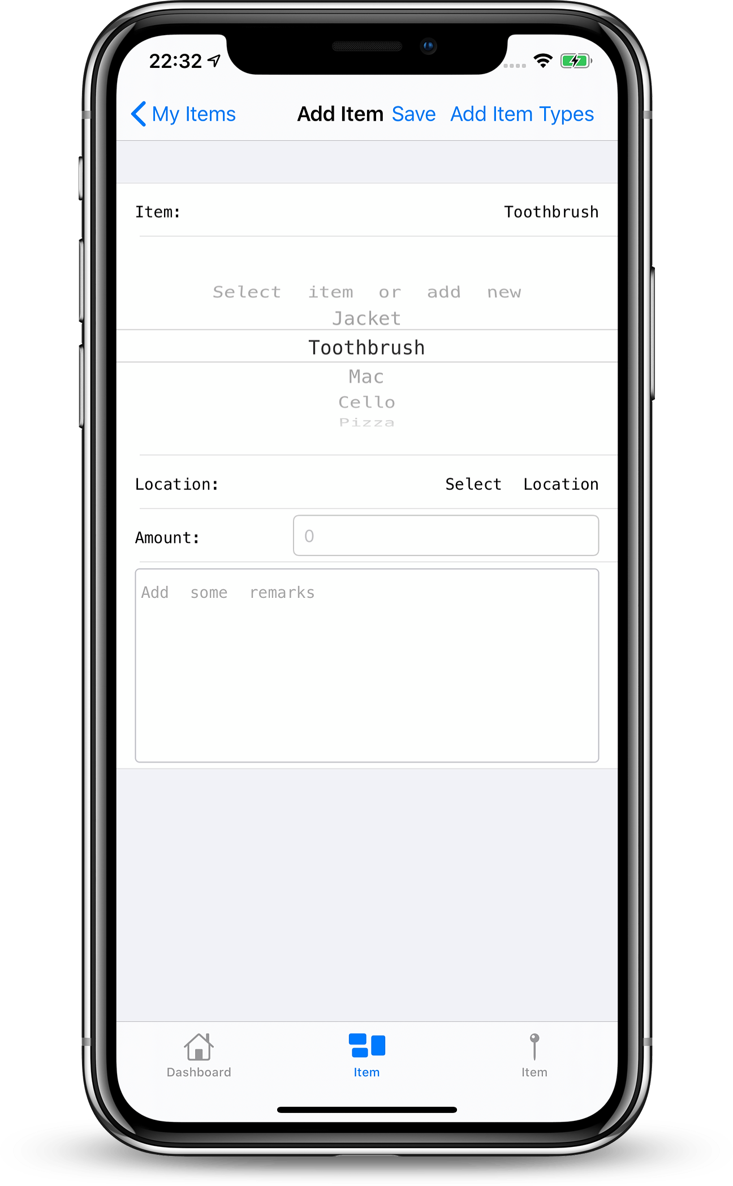
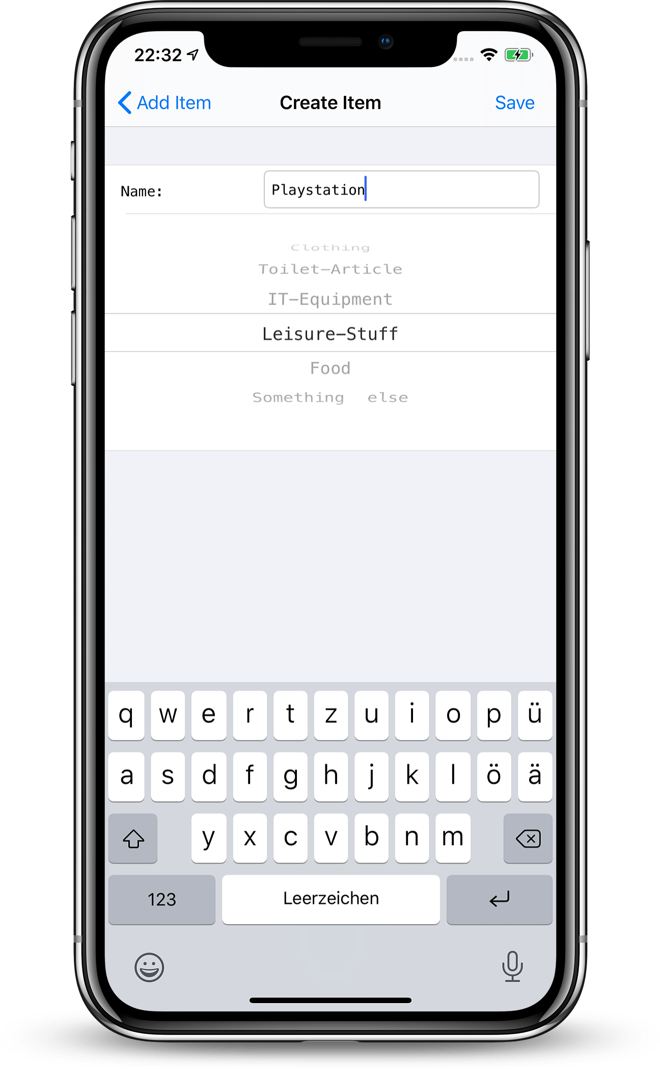

Slide 11
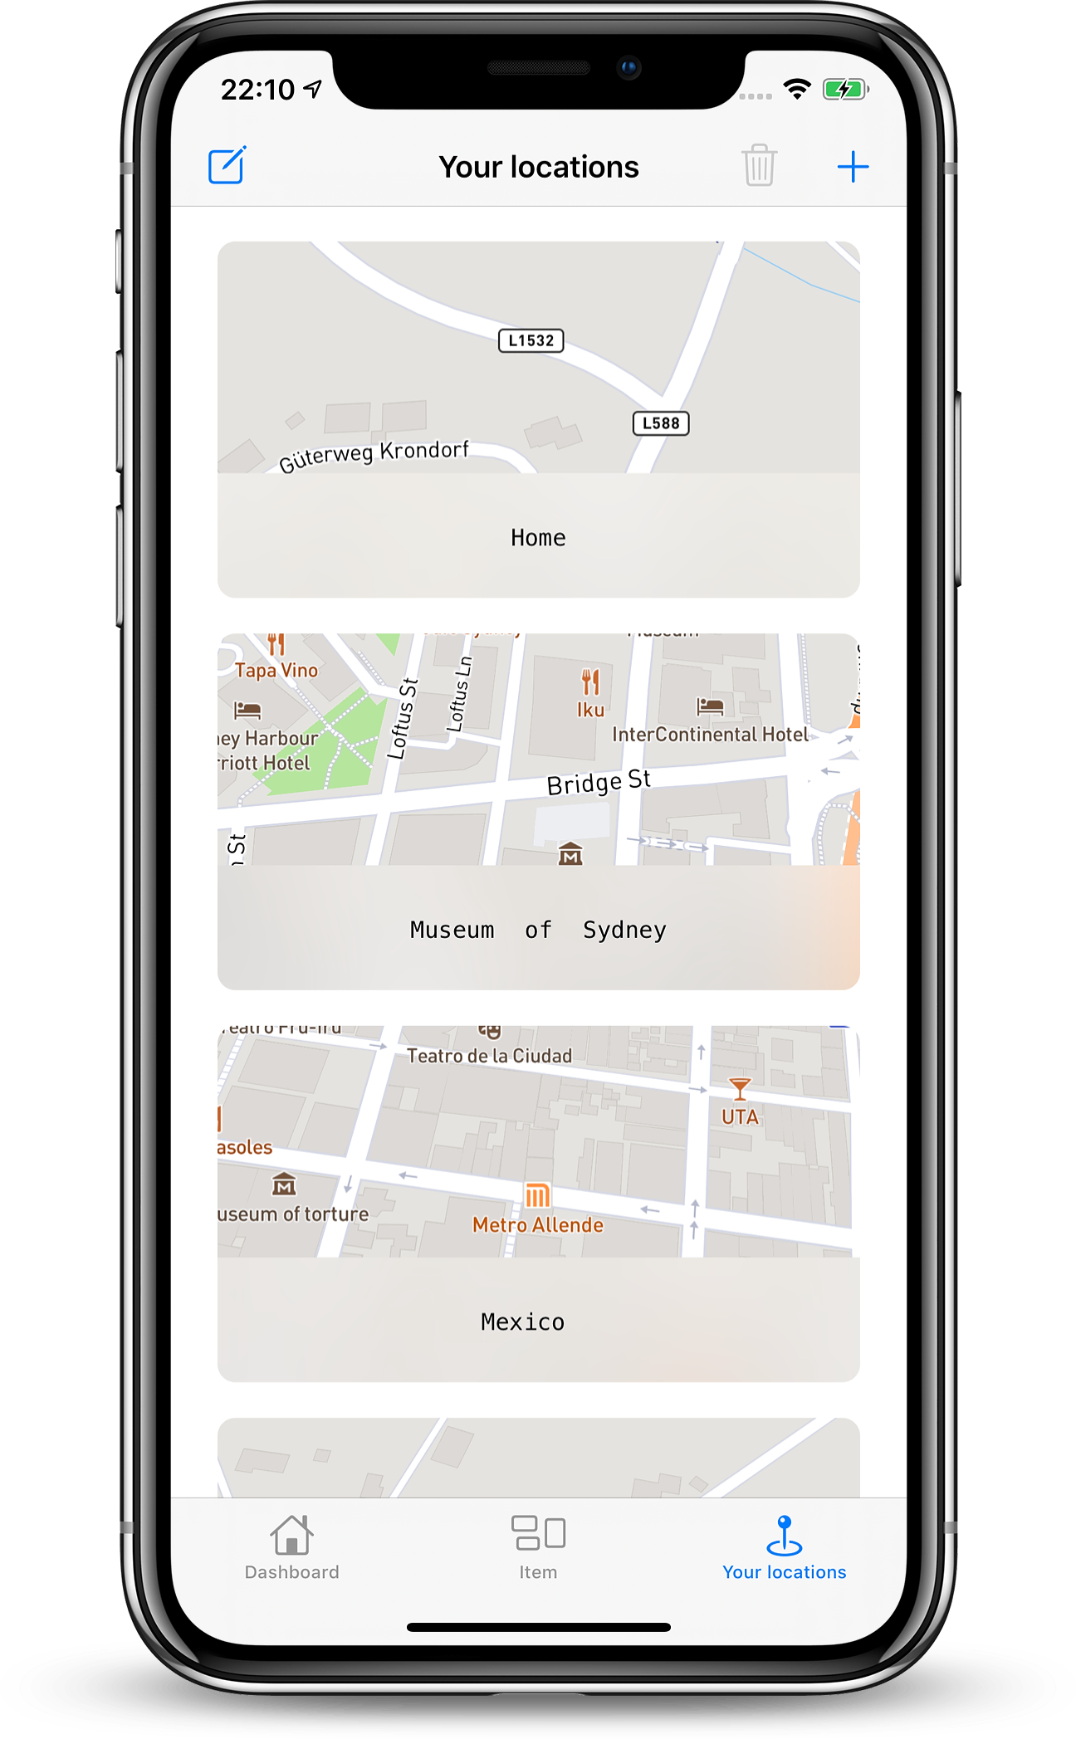

Slide 12
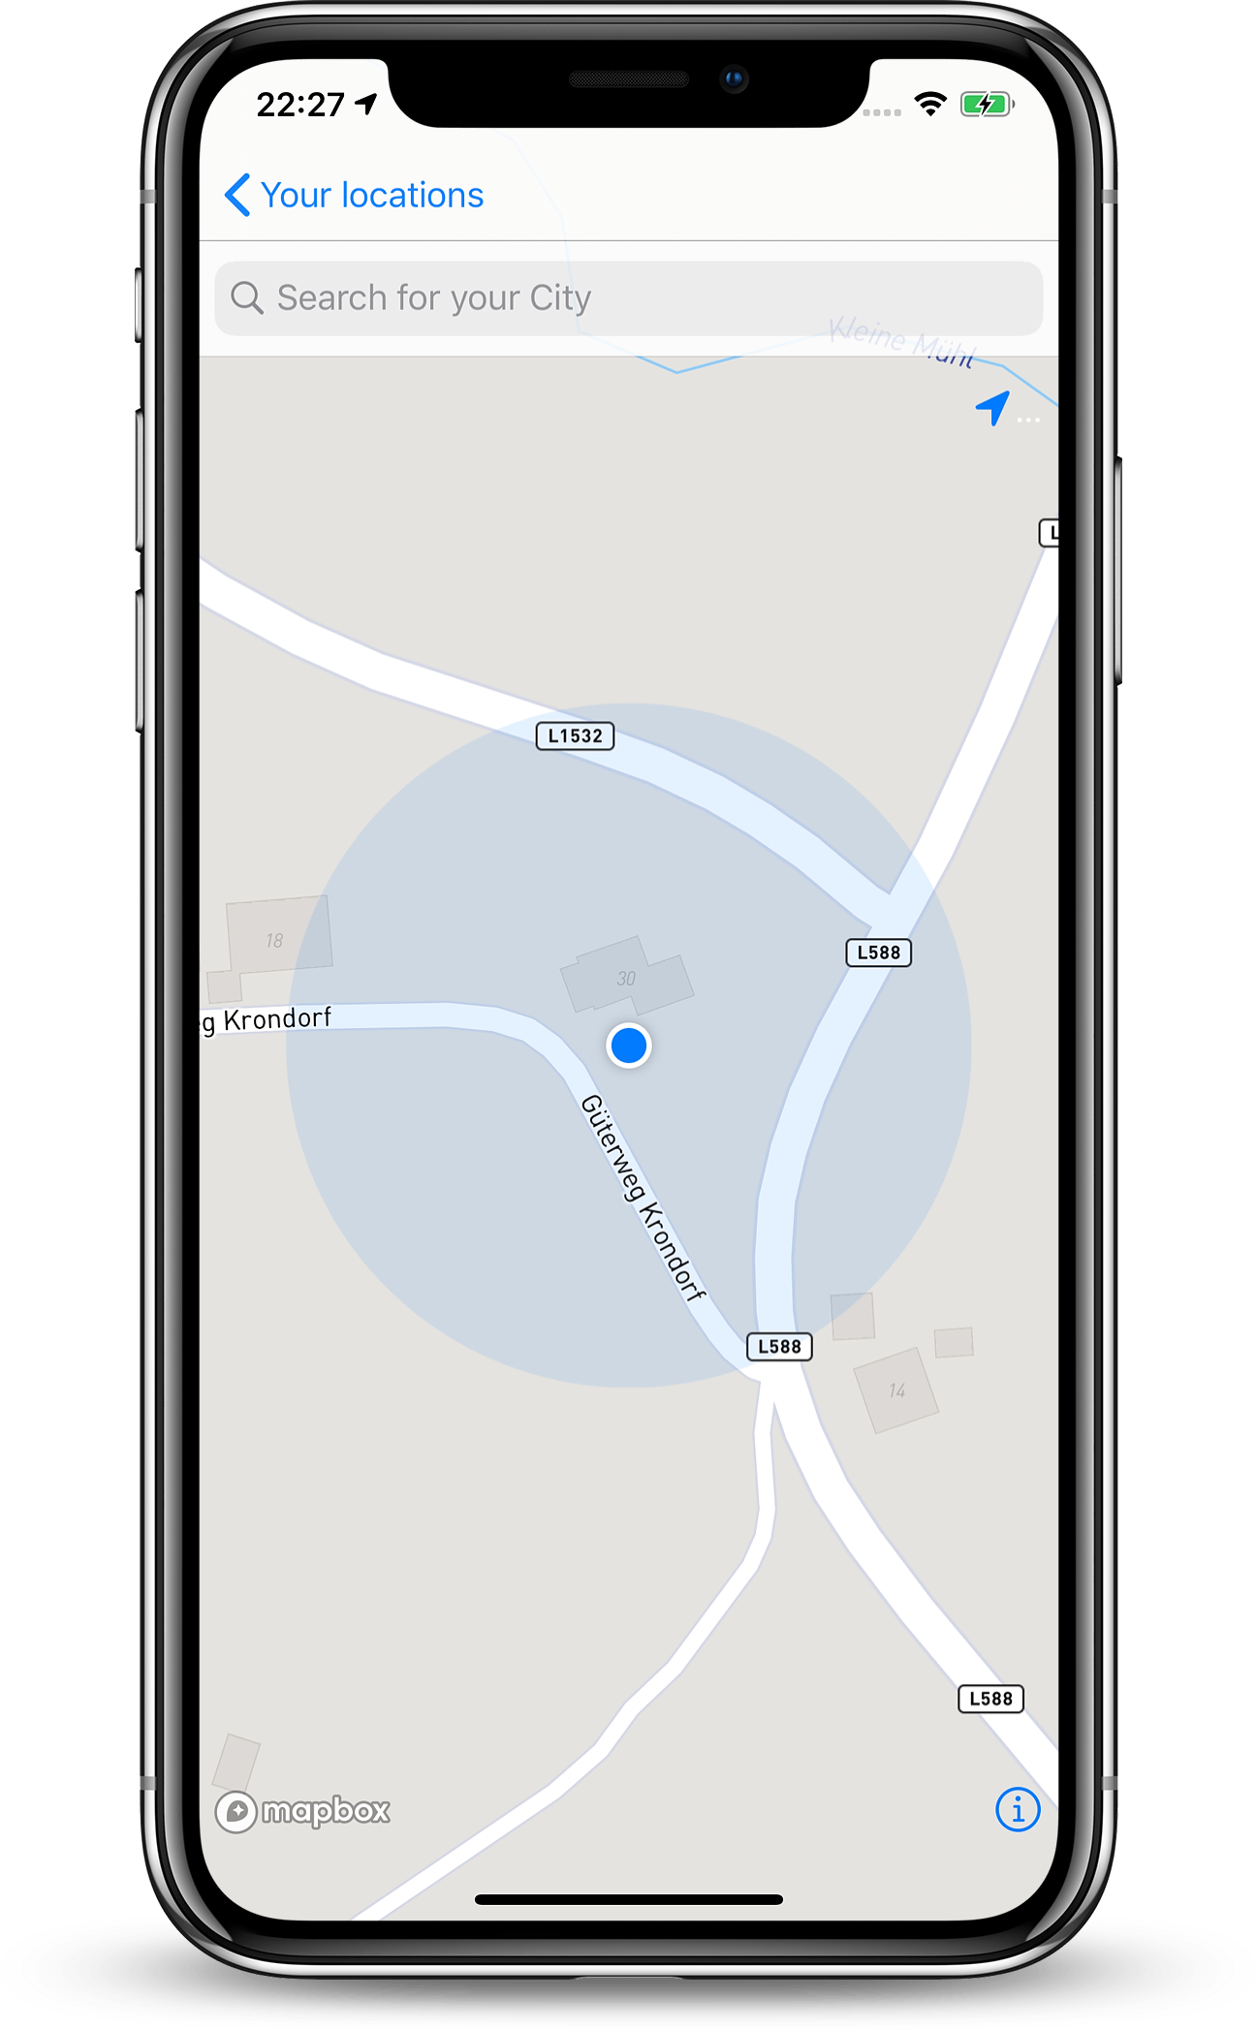
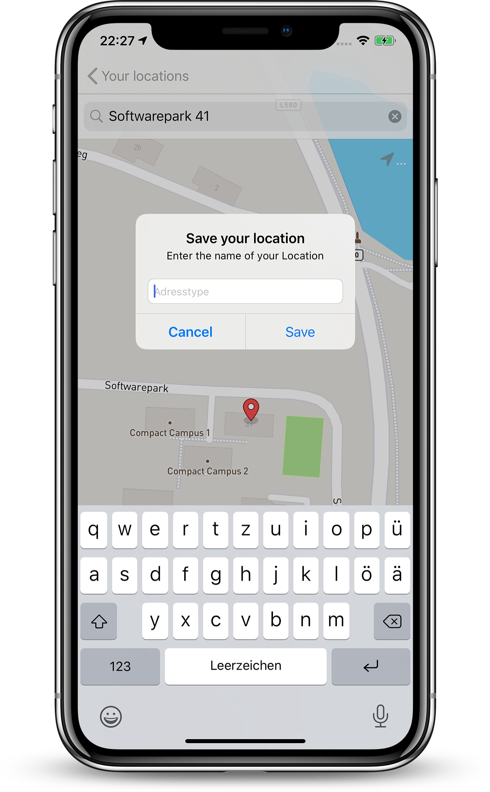

Slide 13



Used APIs
MapBox
UICollectionView
CoreLocation
CoreData

Slide 14

Road ahead
AppStore Launch
More Features
General Improvements

Slide 15
Thank you for your attention

